Slide 1

Presentation of an app for calculating the cost of residential real estate
Polina Mitrikovskaia • 08.23.2018

Slide 2
Overview
Purpose
Estimation of the market value of residential real estate
Required platform
Android, iOS
Settlements
Ames City Iowa
Suburban of Ames City

Slide 3

App development
Used technologies
Python 3.6
1C:Enterprise 8.3
Used resources
Dataset of the price of homes at sale for the Ames Iowa Housing

Slide 4

Model development
Methods
Cleaning up data
Feature engineering
Exponentiation and scaling
Lasso regression (alpha~78)
Results
Regression model with score ~ 0.919

Slide 5

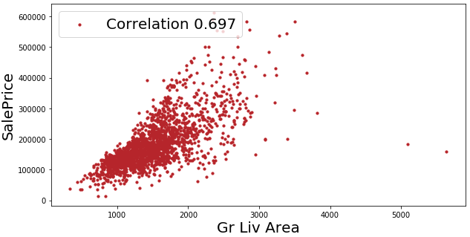
Feature engineering: selection

Slide 6
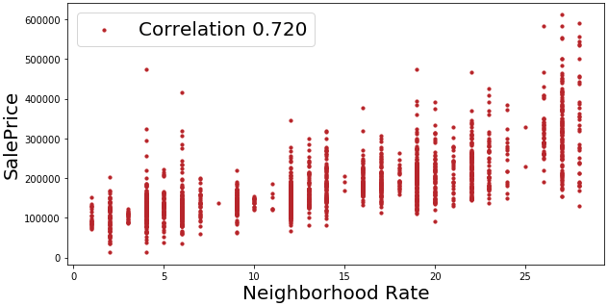
Feature engineering: new data

Slide 7
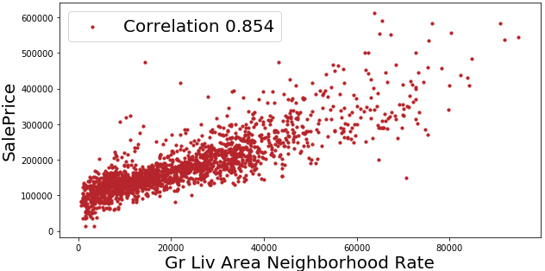
Feature engineering: interaction

Slide 8

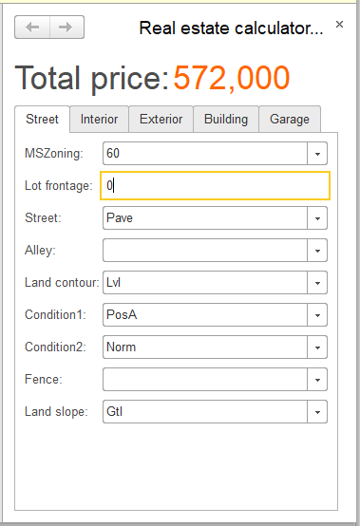
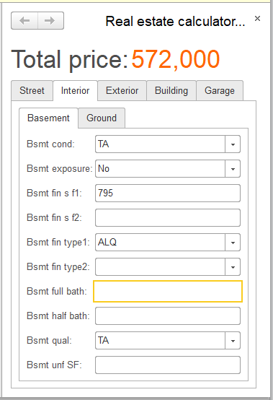
App: interface

Slide 9
More opportunities

Slide 10

Prediction future prices
Conditions
We need to collect data on past sales of real estate. It is possible, for example we have such data on Zillow.com
Model
Regression model that predict data on time scale
Implementation
As a script, a program or a mobile application

Slide 11
Thank you!
Any questions?

